Slide 1
Technical Design
Sirius Accounts

Slide 2
History
Accounts was built from a third party product called Orion.
This project name still remains in SourceSafe today.
Originally intended as a plug-in to Sirius but now fully integrated.
Accounts is a double-entry accounting sub-system.
It all adds up to zero
Credits are negative
Debits are positive
Every Party transacted against in Back Office will have an account.
But not every Account will have a Party. E.g. Tax, Revenue.

Slide 3
Accounts Structure
Ledger
Ledger.current_period_id = Period.period_id
Period
AccountStatus
ledger_id
accountstatus_id
Account
account_id
StructureTree
parent_node_id=node_id
accounttype_id
AccountType
Account.account_id=Party.account_key
element_id
mapping_id
Party
Element
Mapping
element_id
ElementExtras
Components
bACTExplorer
iACTExploer

Slide 4
Multi-Currency
There are four main currencies in Sirius
Transaction, Base, Account, System
Claims also has Loss Currency
Components
bACTCurrencyConvert
bACTCurrency
bACTCurrencyRate
iACTCurrencyRate
uctSIRMultiCurrency
Currency_Rate
currency_id
Currency
Company/Source
Branch Base Currency
currency_id
currency_id
currency_id
currency_id
currency_id
TransDetail
Transaction Currency
PMSystem
System
Currency
in record id 1
Account
Account Currency
currency_id
Claim
Loss Currency

Slide 5
Currency Conversion in VB
bACTCurrencyConvert.Form
ConvertCurrencyToBase
Converts Currency to Branch Base
ConvertBaseToCurrency
Converts Branch Base to another Currency
CurrencyToCurrencyConversion
Converts one Currency to another using triangulation (via base)
DoCurrencyConversion
Converts Currency to Base, Account and System
FormatCurrency
Formats an Amount in the Currency’s format

Slide 6
Currency Conversion in SQL
spu_ACT_Do_Currency_Conversion
Converts Currency to Base and optionally Account and System.
@mode parameter = ‘BASE’ to just convert to base
spu_ACT_Currency_To_Currency_Conversion
Converts Currency to Currency

Slide 7
Transaction Structure
Period
Sub_Branch
Account
period_id
sub_branch_id
company_id
account_id
TransDetail
company_id
Company/Source
accounttype_id
document_id
AccountType
Document
transdetail_type_id
currency_id
amount_currency_id
account_currency_id
system_currency_id
underwriting_year_id
TransDetail_Type
tax_group_id
Underwriting_Year
tax_band_id
Currency
Tax_Band
Tax_Group

Slide 8
Postings
Account
Document
account_id
document_id
TransDetail
Account Document Ref Type Amount
DDAVIS SND0000001 GROSS 120.00
DDAVIS SND0000001 TAX 20.00
INCOME SND0000001 -105.00
TAX SND0000001 TAX -20.00
AGENT SND0000001 COMM -15.00
Components
bACTDocumentPost
Example: bACTCashListPost.Automated.PostUnallocatedCash

Slide 9
Allocation
Linking one-many TransDetail records to one-many others.
Allocation
MatchGroup
allocation_id
match_id
AllocationDetail
allocationdetail_id
TransMatch
transdetail_id
transdetail_id
write_off_reason_id
Components
Write_Off_Reason
TransDetail
bACTAllocationManual
bACTAllocationPost
bACTAllocation
iACTAllocation

Slide 10
Data Flow from Back Office
Account
Stats_Detail
Transaction_Export_Detail
TransDetail
Stats_Folder
Transaction_Export_Folder
Document
Underwriting
Underwriting and Broking
Accounts
Non-Party accounts auto-generated
Transaction_Export_Detail.mapping_code -> Export_Map_Detail.target_field_name
Export_Map_Detail.export_map_detail_id -> Export_Map_Format.export_map_detail_id
Export_Map_Format.Sequence = 1 -> Account Type Export_Map_Format.Sequence = 2 -> Export_Map_Format.leading_characters -> Mapping.description
Mapping.mapping_id = StructureTree.mapping_id
StructureTree.node_id -> parent_node_id of record
Components
bACTImportSiriusTrans
bSIROrionLink

Slide 11
Receipts and Payments
BankAccount
bankaccount_id
CashList
MediaType
account_id
cashlist_id
mediatype_id
mediatype_validation_id
Account
account_id
CashListItem
MediaType_Validation
mediatype_issuer_id
account_id
transdetail_id
cashlistitem_id
MediaType_Issuer
TransDetail
CashListItem_Instalments
pfinstalments_id
PFInstalments
Components
bACTCashListItem
bACTCashListPost
bACTCreditCard
iACTCashListItem
uctACTCreditCard

Slide 12
Credit Control
Tracking and chasing debt from customers.
Credit_Control_Rule
credit_control_rule_id
Credit_Control_Step
Account
credit_control_step_id
Document
Credit_Control_Item
Insurance_File
PFInstalments
Components
PFPremiumFinance
bACTCreditControl
bACTCashListPost
iACTCashListItem
uctACTCreditCard

Slide 13
Instalments and Premium Finance
Splitting debt into parts
Components
bSIRPremiumFinance
bSIRPFInstalments
bSIRPFRF
bSIRPFScheme
bSIRPFExport
iPMBFinancePlanQuote
iPMBFinancePlanMaint
iPMBFinanceTransactions
iPMBFindFinancePlan
iPMBPFExport
iPMBPFRF
iPMBPFScheme
iPMBPFSchemeMaint
uctInstalmentsControl
PFScheme
CompanyNo SchemeNo SchemeVersion
Party
PFRF
Clientid
TransDetail
(instalment debt)
pfrf_id
plantransdetail_id
PFPremiumFinance
PFTransaction_id
(transactions on plan)
pfprem_finance_cnt pfprem_finance_version
pfprem_finance_cnt pfprem_finance_version
pftransaction_id
PFInstalments
transdetail_id
TransDetail
Instalments Only

Slide 14
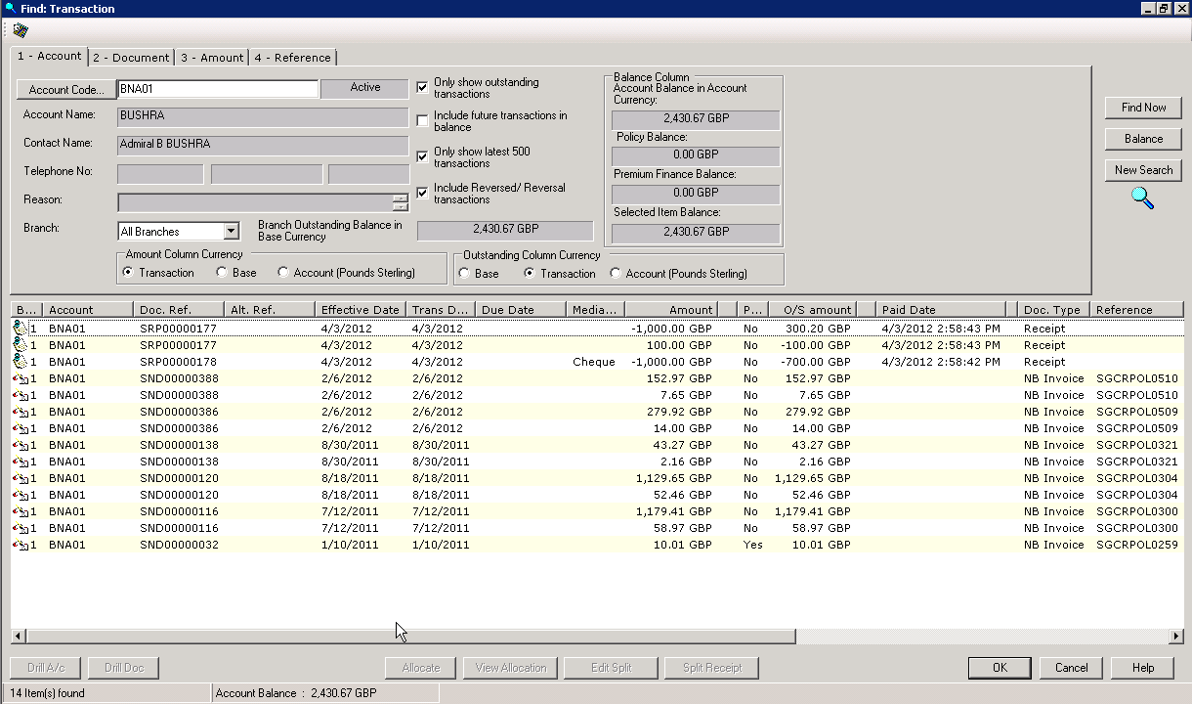
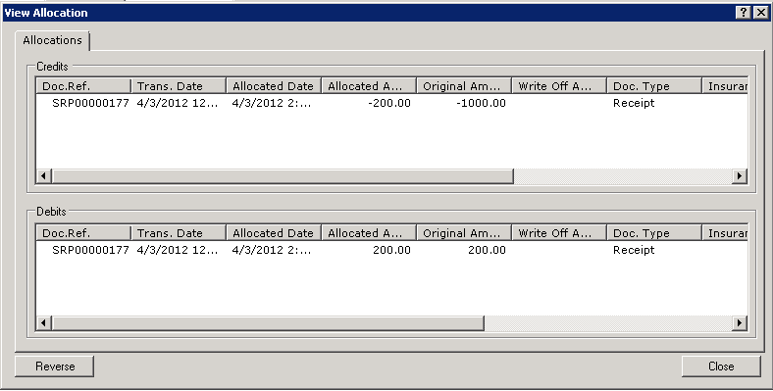
Find Transaction
Work on individual transactions
Can roll up multiple document transactions into one
Perform allocations
Reverse Allocation
Components
bACTFindTransaction
iACTFindTransaction
iACTAllocation

Slide 15
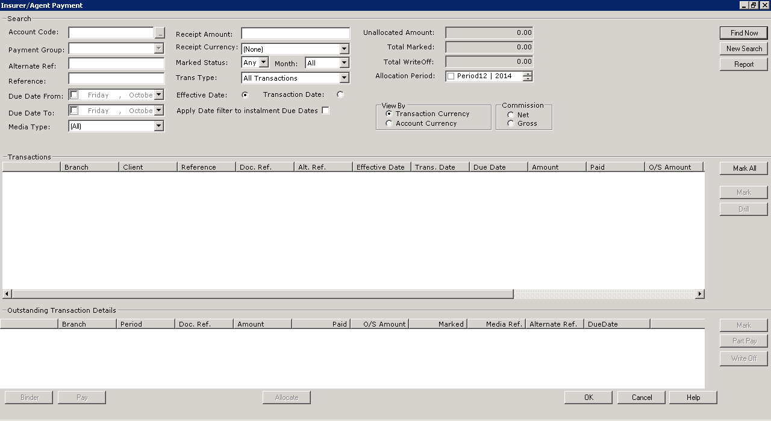
Insurer/Agent Payment
Similar to Find Transaction
Designed for clearing large volume accounts
Generates payment for multiple transactions
Binder rolls up groups of transactions
Components
bACTInsurerPaymentSFU
iACTPaymentSFU

